Slide 1

NLP For Querying Database
Group# 28
Vishal Oswal
Harshil Shah
Ameya Hanamsagar
Rakesh Bora

Slide 2

Project Goal
Processing natural language to interact with system to find restaurants
Full end to end dialogue system
Trade off with user preferences

Slide 3

Project Domain
System searches for information in the restaurant domain
Attributes used for searching the restaurants
Price
Cuisine
Location
Service rating

Slide 4

Project Modules
Speech recognizer
Natural Language Understanding
Dialogue Management
Natural Language Generation
Speech Synthesizer

Slide 5

Natural Language Understanding Approach 1 – Keyword based
Keyword based extraction
Synonyms replaced with keywords
Rapid Automatic Keyword Extraction [RAKE] for keyword extraction
Searching criteria includes
Cuisine
Price
Distance
Notes:
RAKE - Removes stop words and extracts the keywords

Slide 6
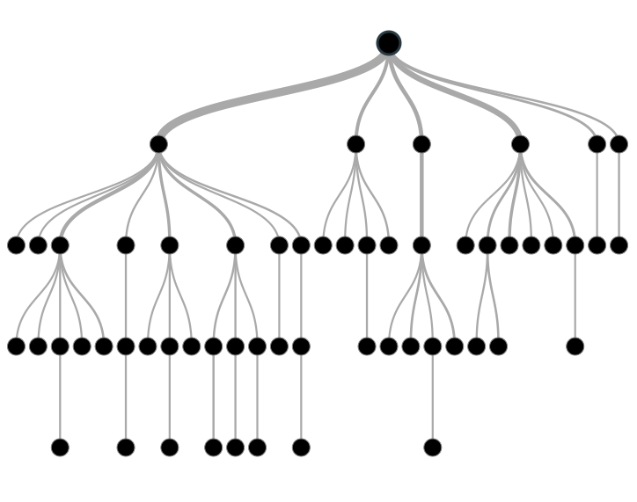
Natural Language Understanding Approach 2 – Classification based
User queries
Training data
Decision Tree
Classifier
User query
Classifier
Label
Training
Classification
Notes:
We used NLTK’s decision tree based classifier.
Training data had 120 sentences covering various patterns to mention either of 3 attributes.
Classifier trained with synonyms as well.
Decision tree based classifier produces an 80% accuracy.
The classification based approach recognizes only one attribute from the sentence based on the way it is trained.
Also tried naïve bayes classifier.

Slide 7


Dialogue management
NLU
Text
“Some fine dine places please”
Label
Dialogue act
Dialogue management
Result
NLG
Speech text
Query
Result
Database
Notes:
Generation of dialogue acts
Requesting users to provide input
Querying the database once all attributes have been collected
Managing user interaction, NLU, NLG, speech recognizer and speech synthesis
Handling trade offs based on preferences & priorities

Slide 8

Natural Language Generation
Template based natural language generation
Generating speech text for
requesting information
confirming information
informing user about searched and trade off results

Slide 9

Evaluation Plan
Individual module evaluation
Whole system evaluation with two NLU approaches
Keyword based approach
Classification based approach
Feedback criteria
Accuracy of system to understand the user search criteria
Relevancy of results
Perceived & actual task completion

Slide 10
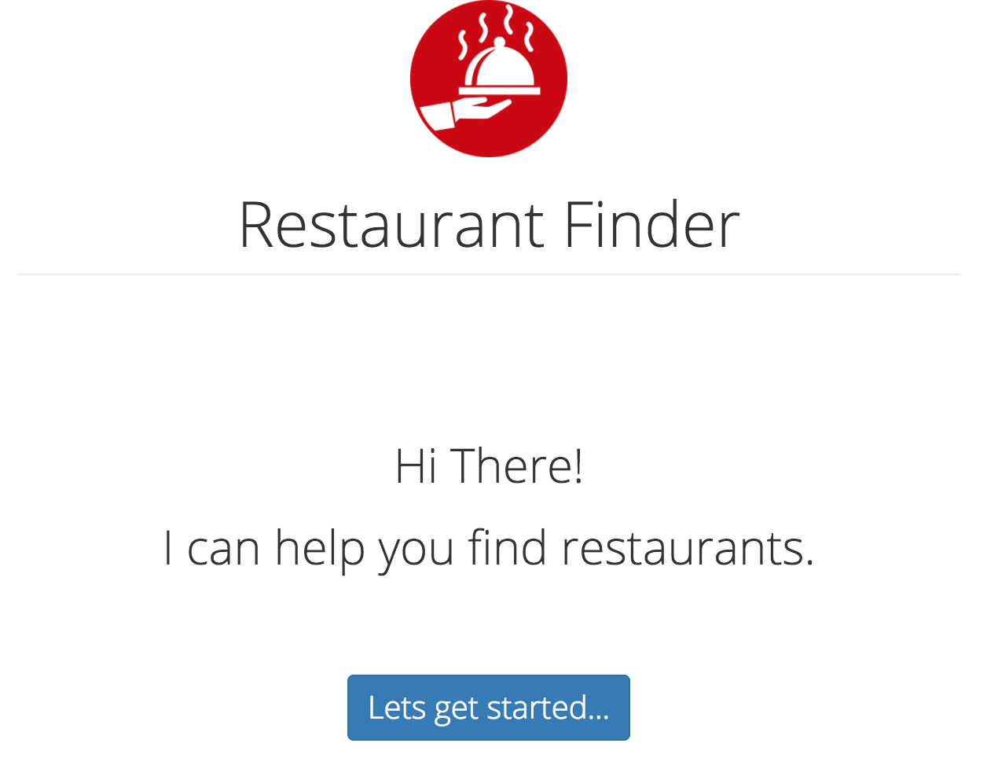
Flow of interaction

Slide 11
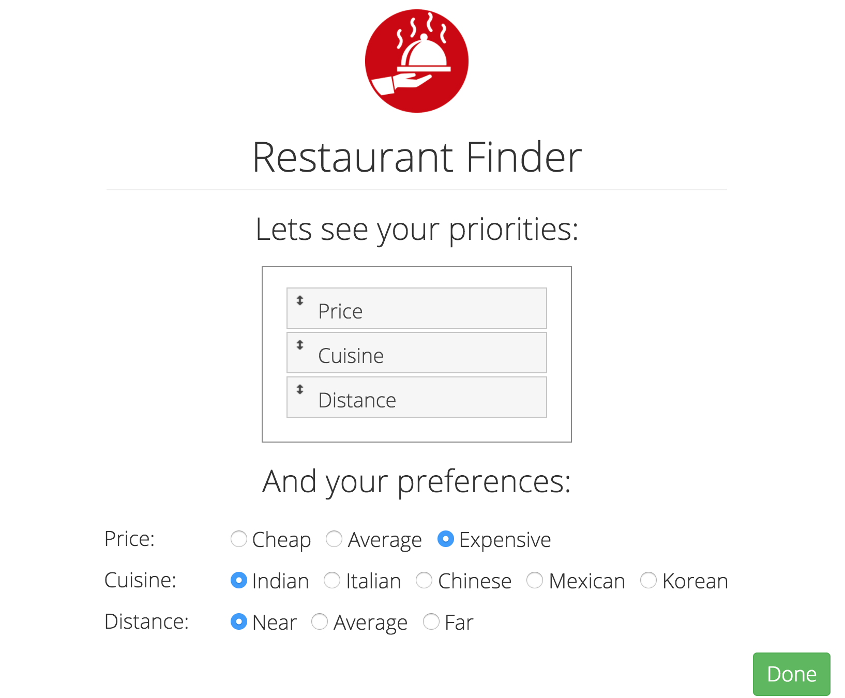
Flow of interaction

Slide 12

Flow of interaction

Slide 13
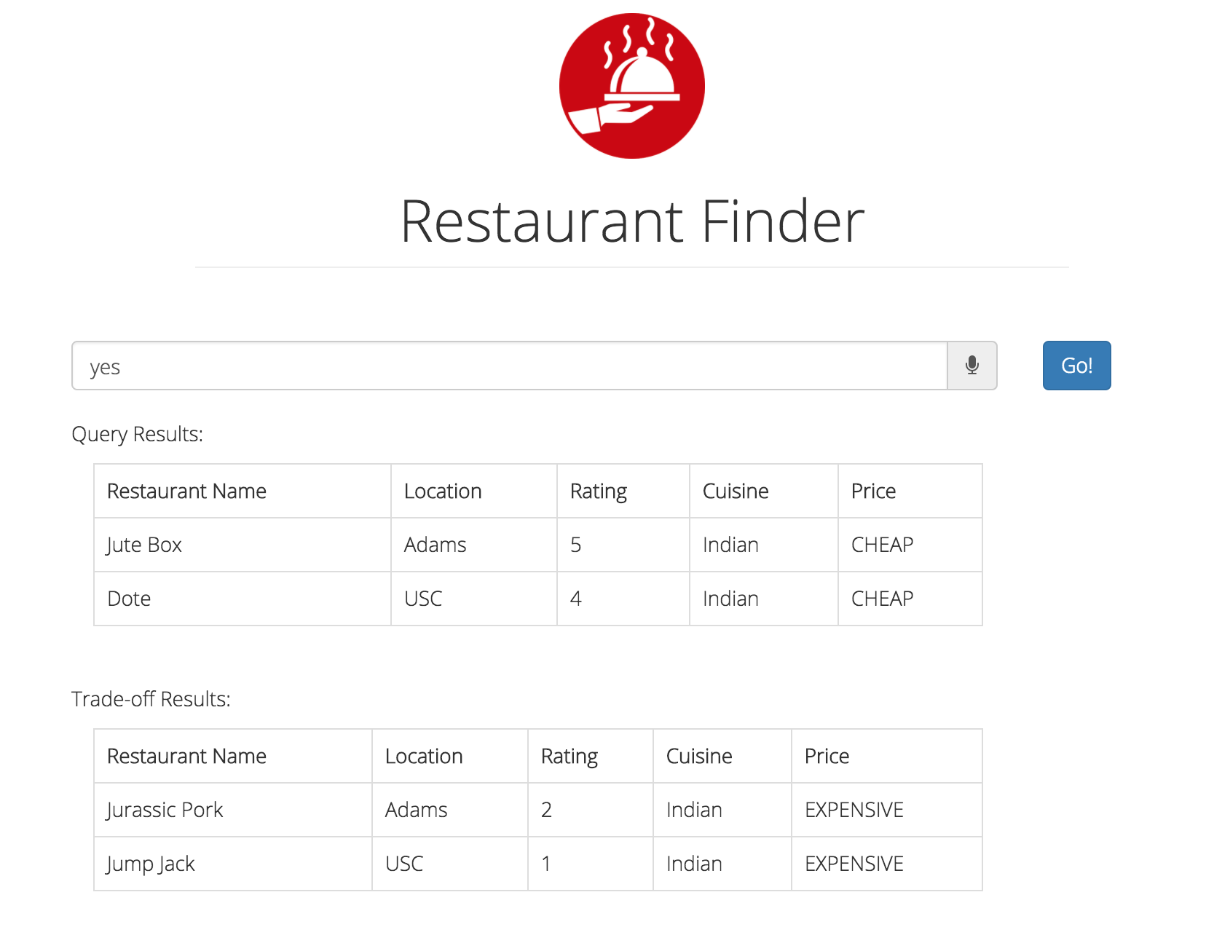
Flow of interaction

Slide 14
References
Paksima, Taghi, Kallirroi Georgila, and Johanna D. Moore. "Evaluating the effectiveness of information presentation in a full end-to-end dialogue system." Proceedings of the SIGDIAL 2009 Conference: The 10th Annual Meeting of the Special Interest Group on Discourse and Dialogue. Association for Computational Linguistics, 2009 - http://people.ict.usc.edu/~kgeorgila/publications/paksima_sigdial09.pdf
RAKE - https://github.com/fabianvf/python-rake
Classification based NLU - http://www.nltk.org/book/ch06.html
Speech Recognizer and synthesizer - https://developers.google.com/web/updates/2013/01/Voice-Driven-Web-Apps-Introduction-to-the-Web-Speech-API

Slide 15
Thank you…!!!
Q/A?

